Slide 1
Hyatt Hotel Merida - Yucatàn, 16-19 October, 2012

Slide 2
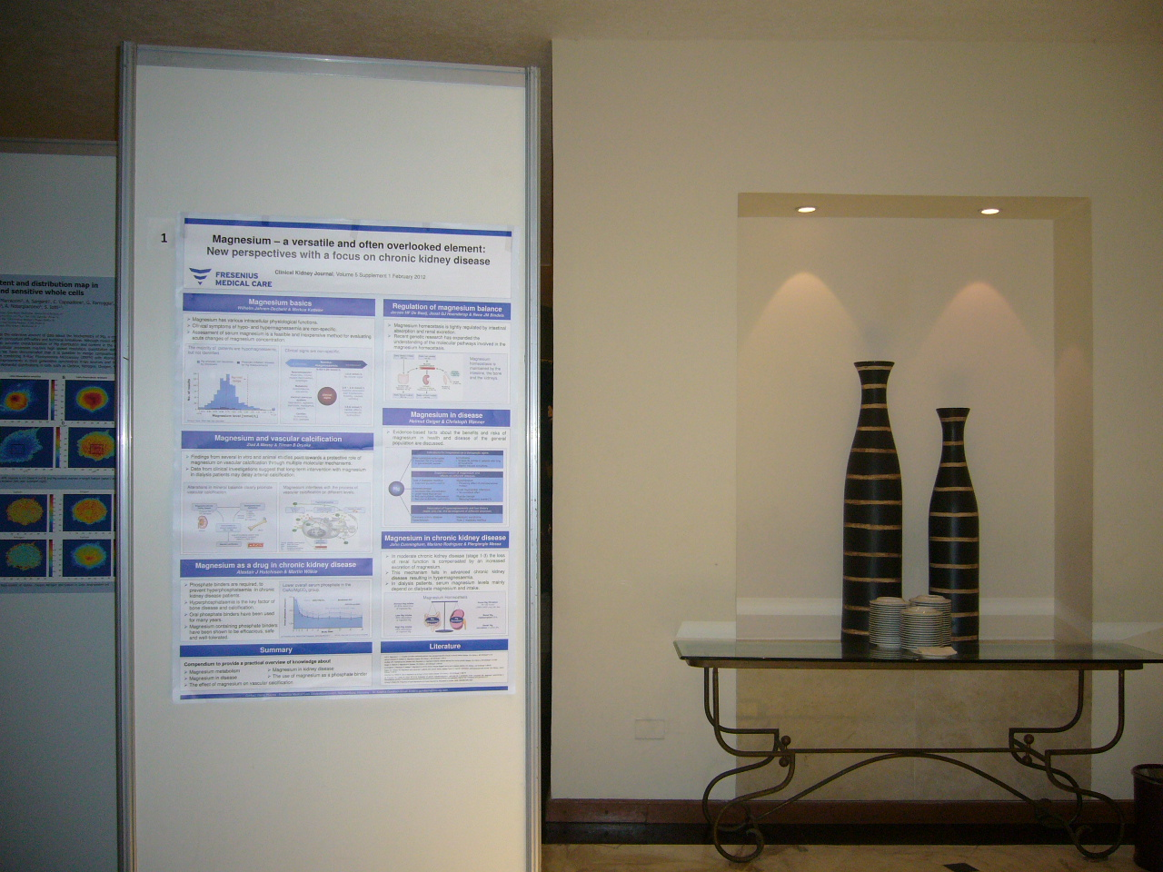

Slide 3
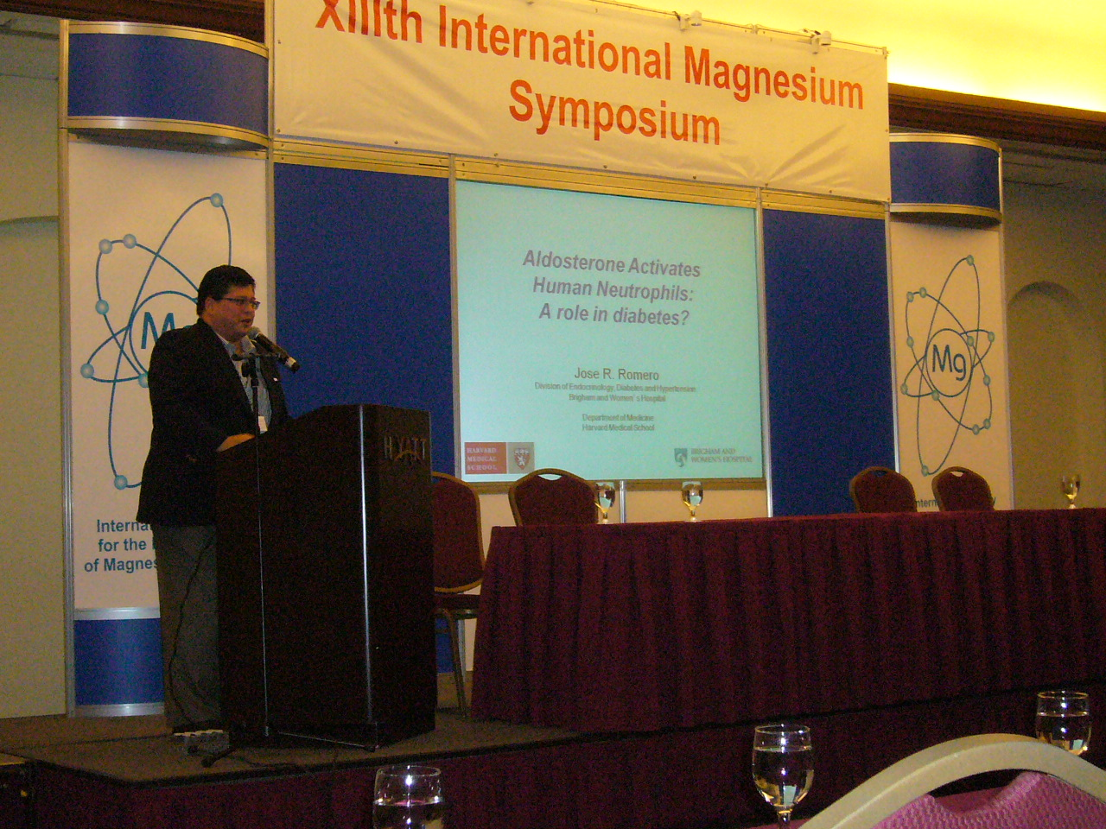

Slide 4
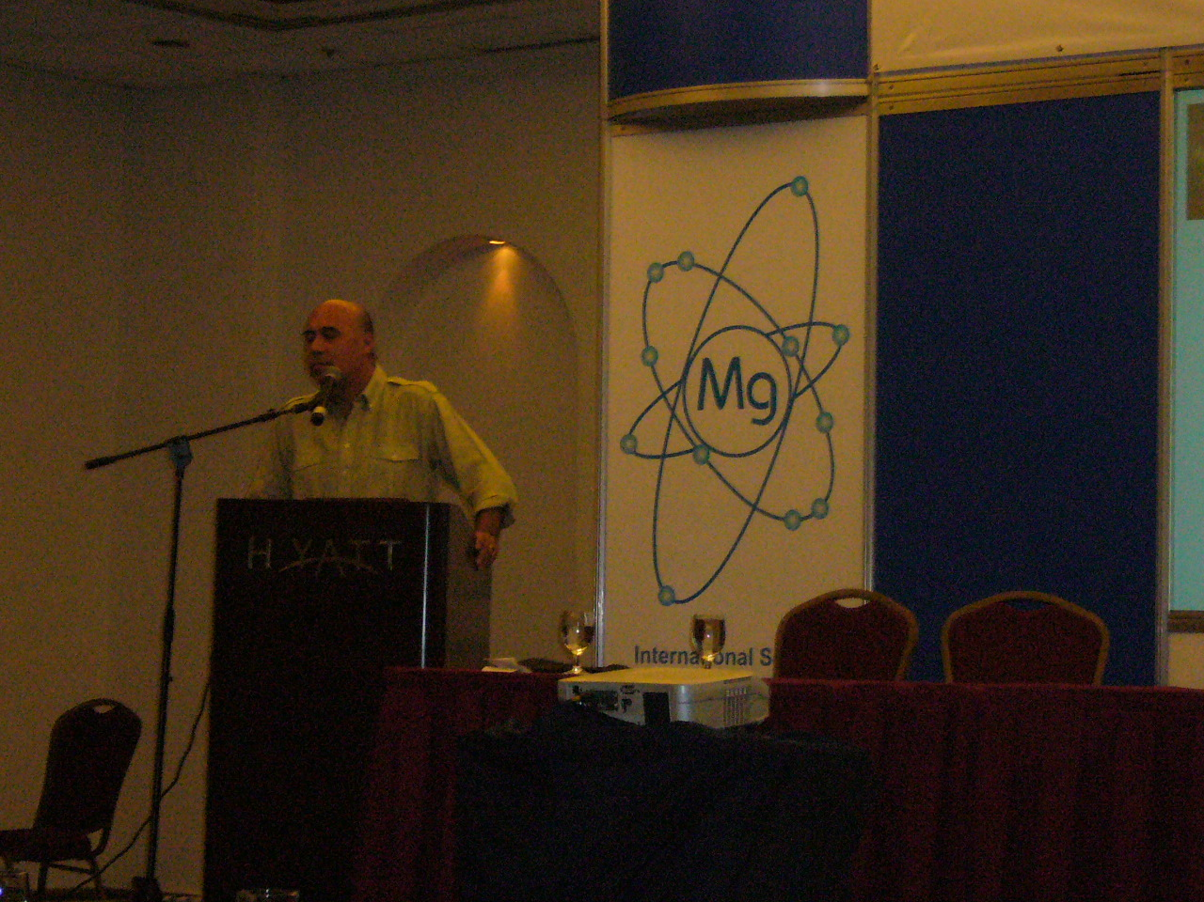

Slide 7
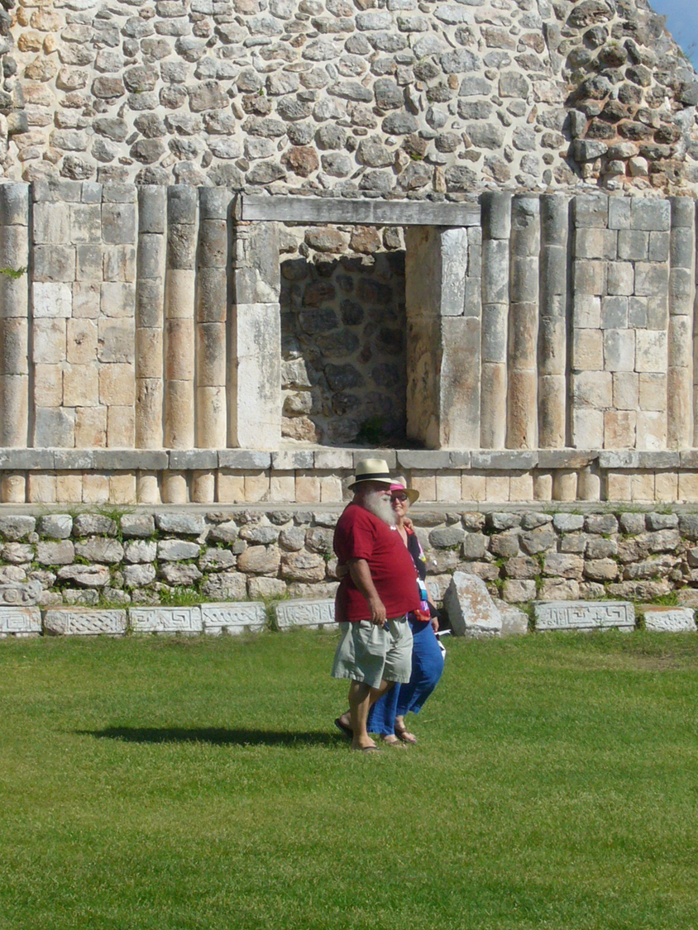
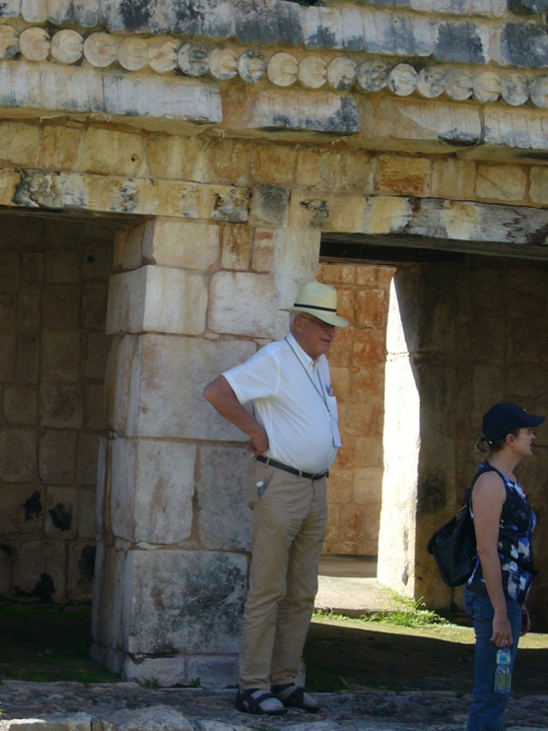
I love you and
...Mg²⁺

Slide 8
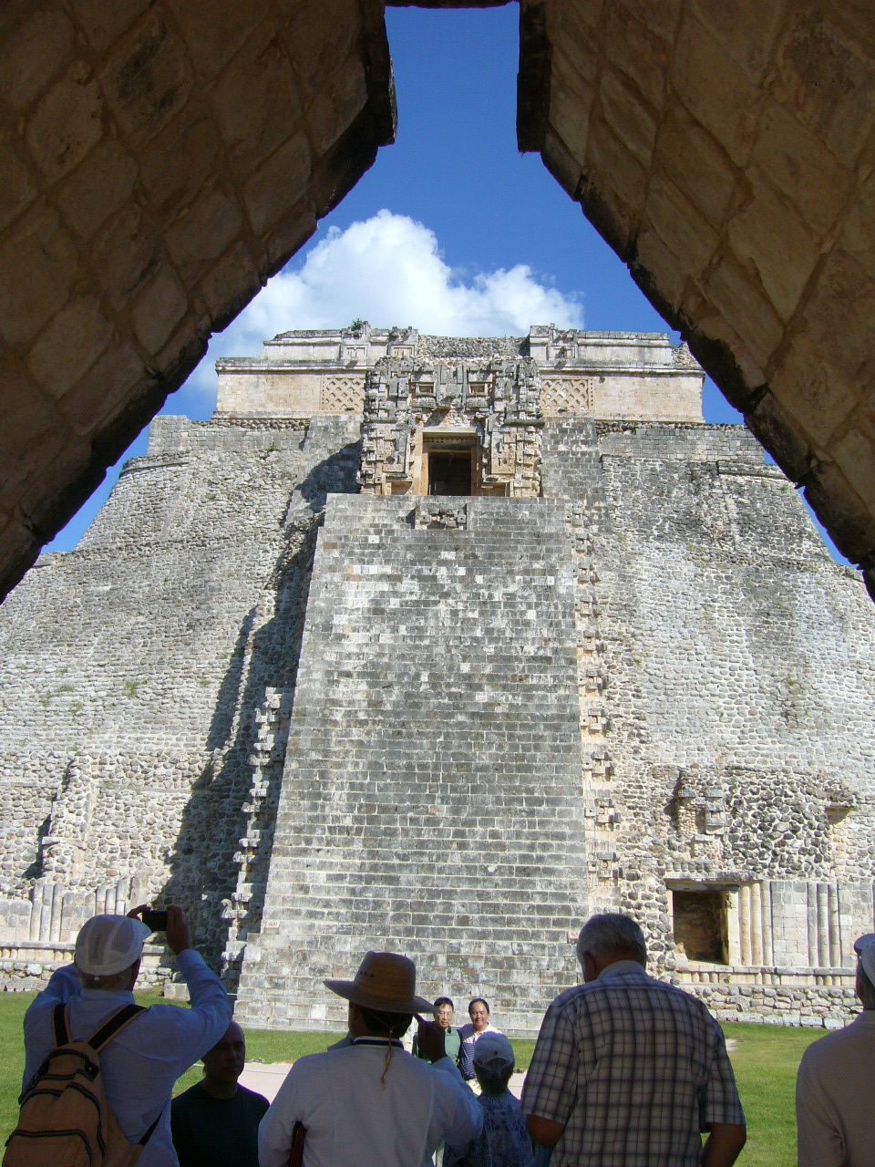

Slide 9
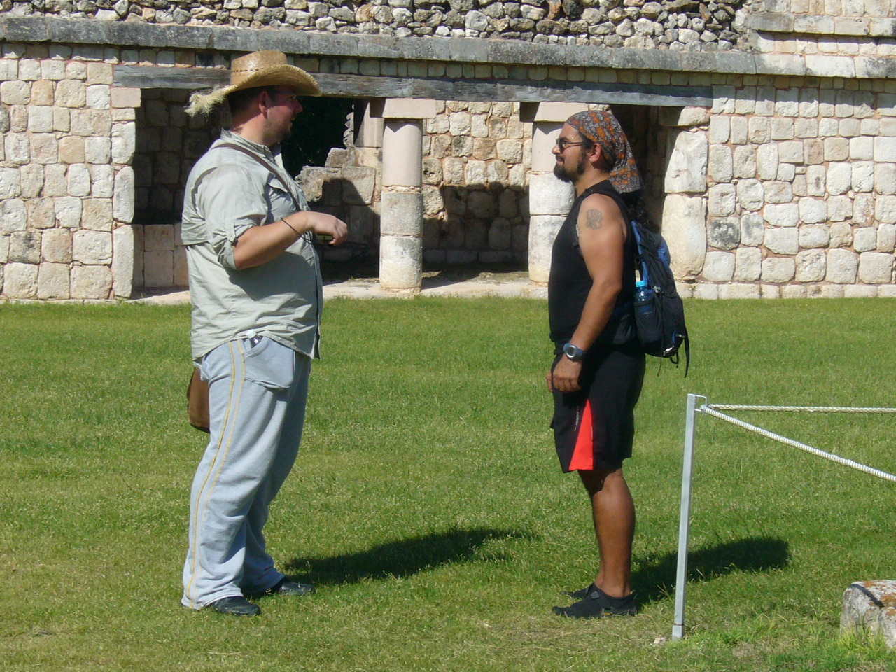

Slide 10
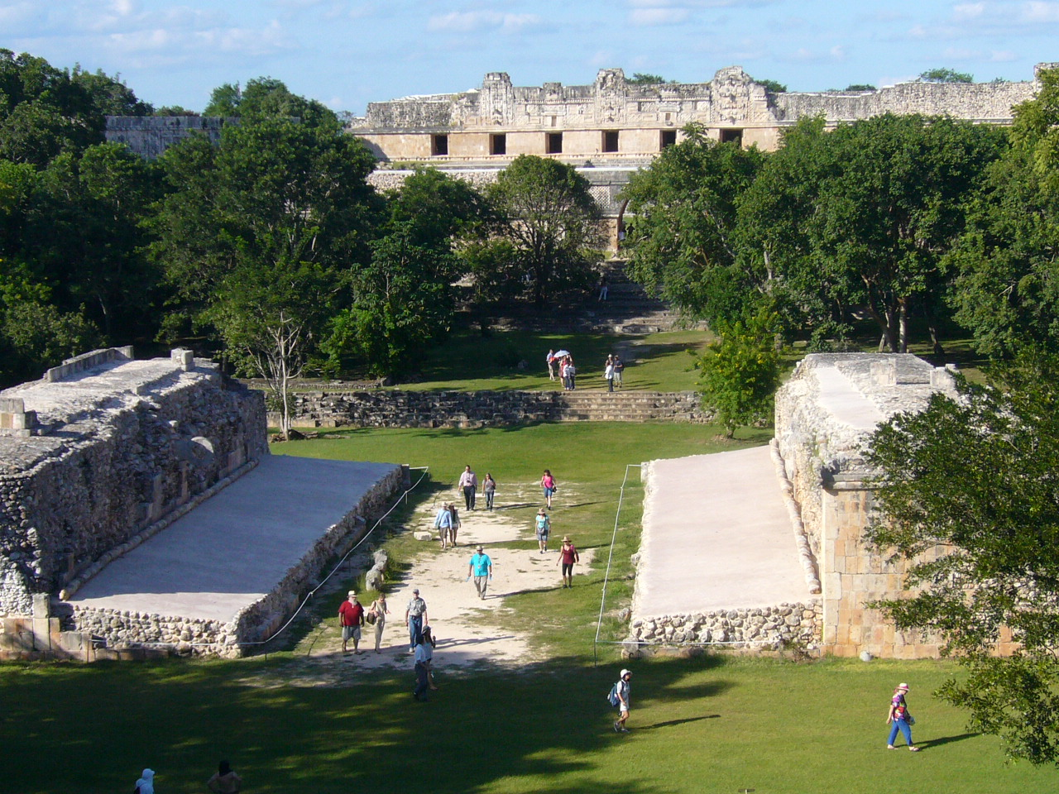

Slide 11
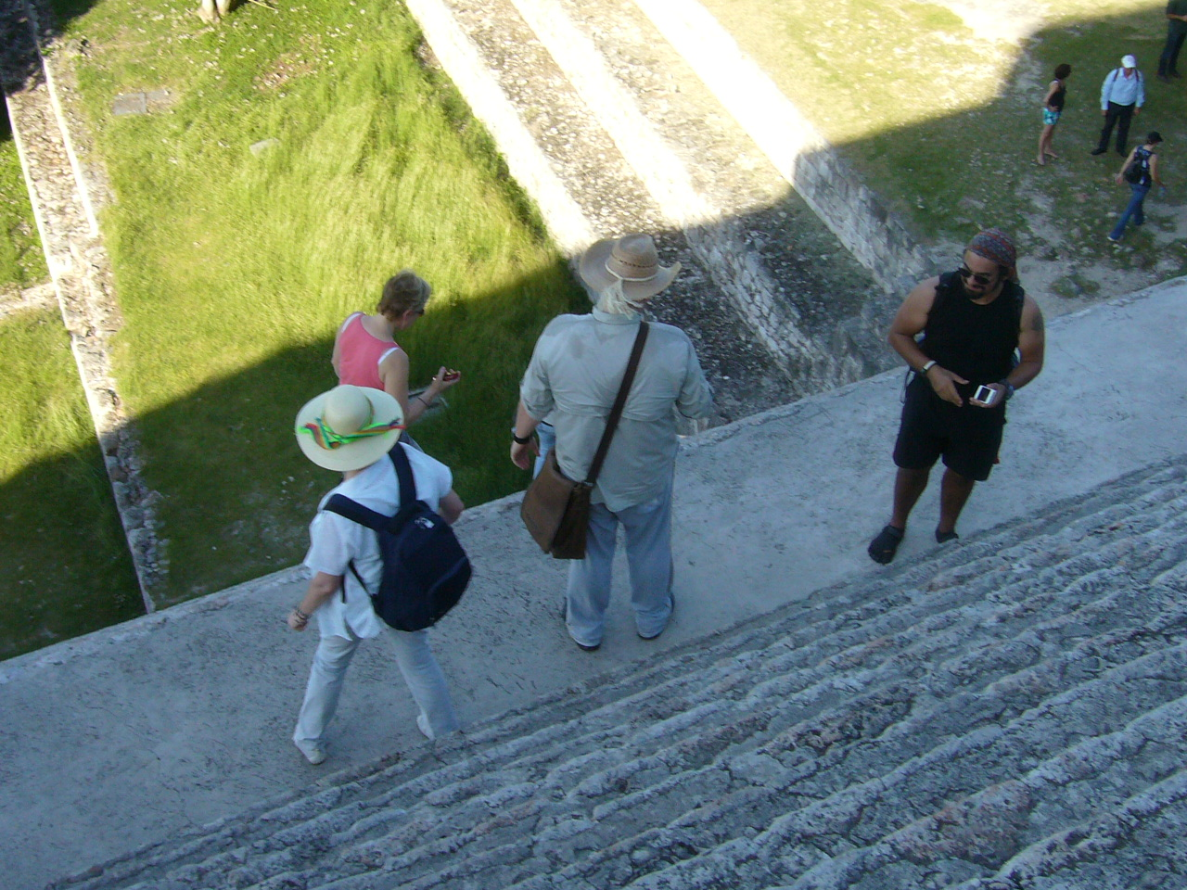

Slide 12
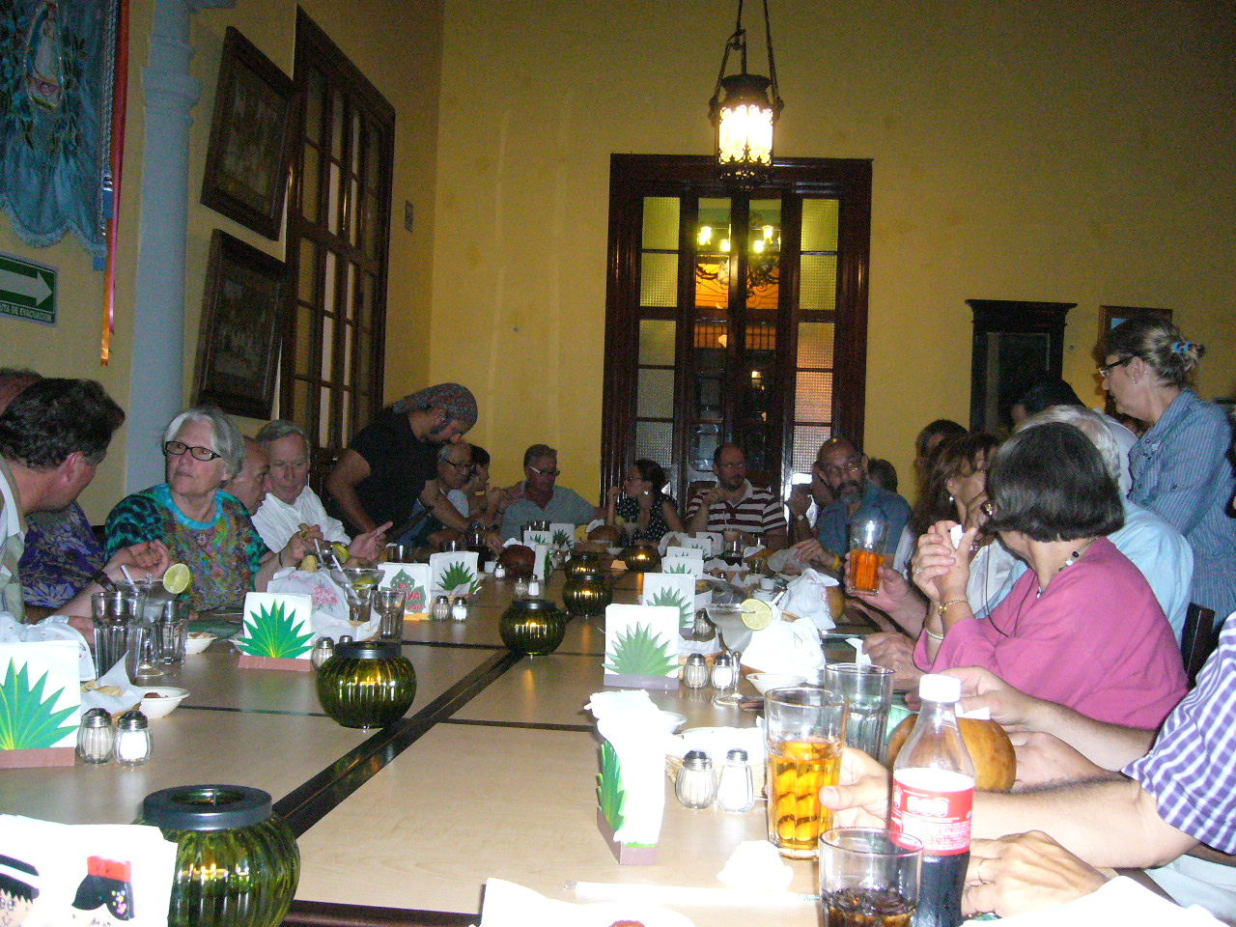

Slide 14
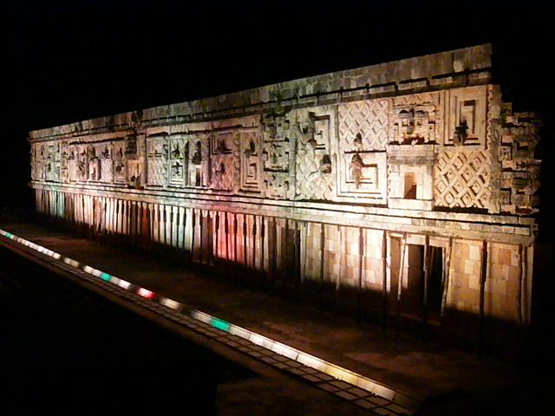

Slide 15
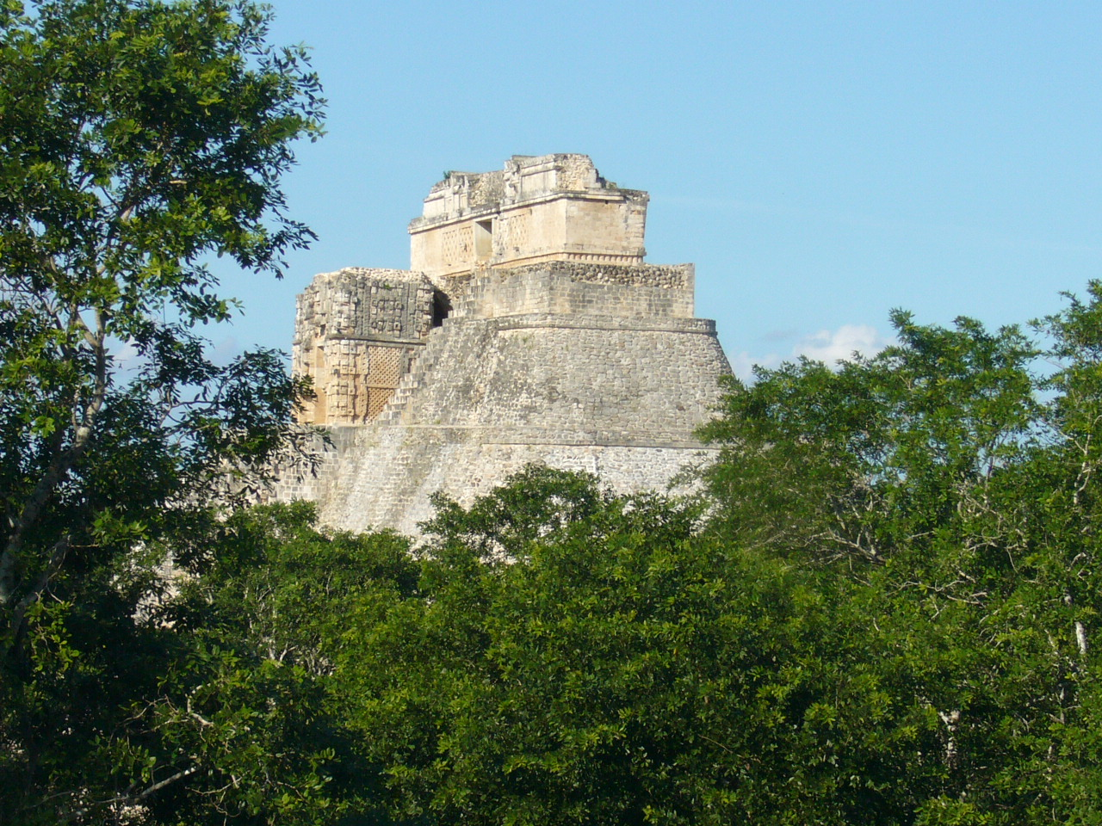
XIII International Magnesium Symposium,
Merida - Yucatàn, 16-19 October, 2012
Fernando, Martha and Fernandoyr
Thank you for such a wonderful
Experience!

Slide 16
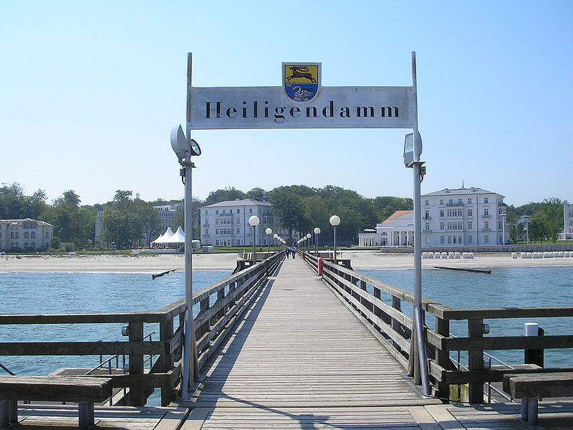
XIV International Magnesium Symposium, 2015
MOVED TO……
Germany

Slide 17
XIV International Magnesium Symposium, 2015
Berlin, Germany

Slide 18
HIGHLIGHTS
EVENTS
Good bye, keep in touch!
NEWS & VIEWS
PHOTOGALLERY

